Slide 1


Commissioning
Air Force ROTC Detachment 842
The University of Texas at San Antonio
C/Col Schrecker & C/Capt Quilantan
14 May 24

Slide 2


Overview
Series of events
Venue Information
Roles
Summary
Air Force ROTC Detachment 842 • We Build Exceptional Officers • The University of Texas at San Antonio

Slide 3
Series of Events

Slide 4
Series of Events 16th
1230: C/Schrecker & C/Quilantan arrive
1300: Cadet Volunteers SHOWTIME
1300-1400: Set up Decorations
1400-1430: Commissionee Practice & Continue Set-Up
1500: Pick up Trash from Set-Up
DEPART BALLROOM
Air Force ROTC Detachment 842 • We Build Exceptional Officers • The University of Texas at San Antonio

Slide 5
Series of Events 17th
1015-1025- Opening Remarks by Brig Gen Nelson
1025-1125- Oath, Pinning, & Salute
1125-1130 Closing remarks from Col Cyrus
1130 Air Force Song
1130-1230 Cake and refreshments
1300 End of event & Clean-Up
0845 VOLUNTEER SHOWTIME
NLT 0900 Commissionees showtime to Det Classroom for Q&A
0915-0945 Q&A w/ Maj. Gen Nelson
Guest showtime 0930-0945
1000: Ceremony starts
1005-1010: the arrival of the official party with cadets marching in
1010-1015: Posting of the colors and national anthem and invocation
Air Force ROTC Detachment 842 • We Build Exceptional Officers • The University of Texas at San Antonio

Slide 6
UOD

Slide 7
UOD
POC & Commissionees
Full Service Dress
GMC
Service Dress (IF YOU HAVE IT)
Open Collar Blues
Det Polo & Khakis
Thursday Set-Up & Run Through
Civies (appropriate)
Air Force ROTC Detachment 842 • We Build Exceptional Officers • The University of Texas at San Antonio

Slide 8
Venue Information

Slide 9
Venue Information
H-E-B Ballroom at UTSA Main Campus
15 Paseo Principal (Google Maps)
Park in Brackenridge Ave Lot 1
You will not get a ticket, it is intersession at UTSA
Air Force ROTC Detachment 842 • We Build Exceptional Officers • The University of Texas at San Antonio

Slide 10
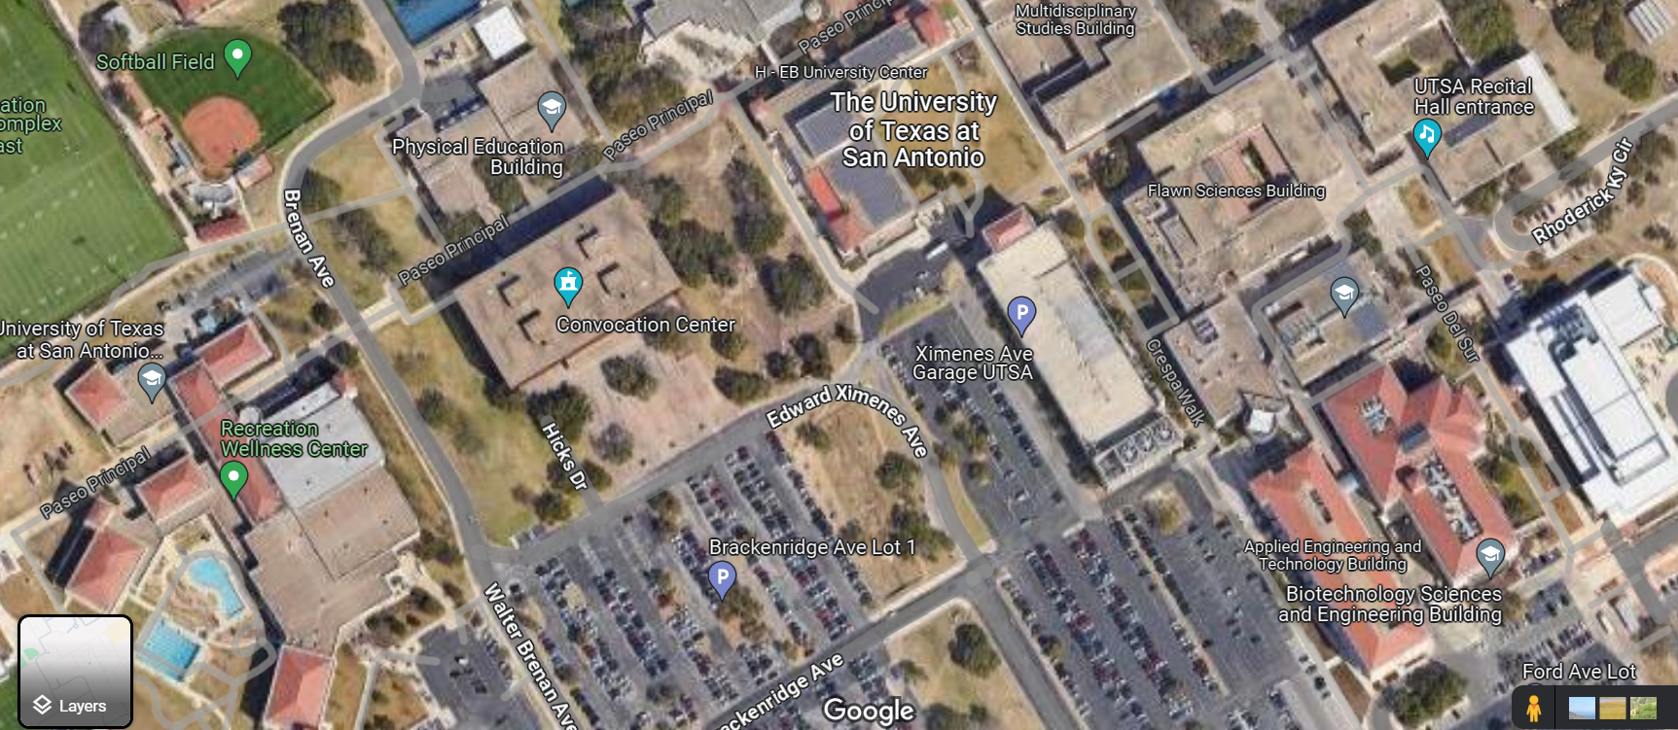
Venue Information
Event Here
Park Here
Air Force ROTC Detachment 842 • We Build Exceptional Officers • The University of Texas at San Antonio

Slide 11
Roles

Slide 12
Roles
LEADS
Schrecker, Quilantan
PA
Eggers
Usher Lead
Fresquez
Guide Lead
Fresquez
Cake/Refreshments
Gussman, Dela Cruz, Perez, Villamaria
Set-Up/Take-Down
Lead: Molloy, Acevedo
Air Force ROTC Detachment 842 • We Build Exceptional Officers • The University of Texas at San Antonio

Slide 13
Summary
Overview
Series of events
Venue Information
Roles
Air Force ROTC Detachment 842 • We Build Exceptional Officers • The University of Texas at San Antonio

Slide 14
Questions?

Slide 15
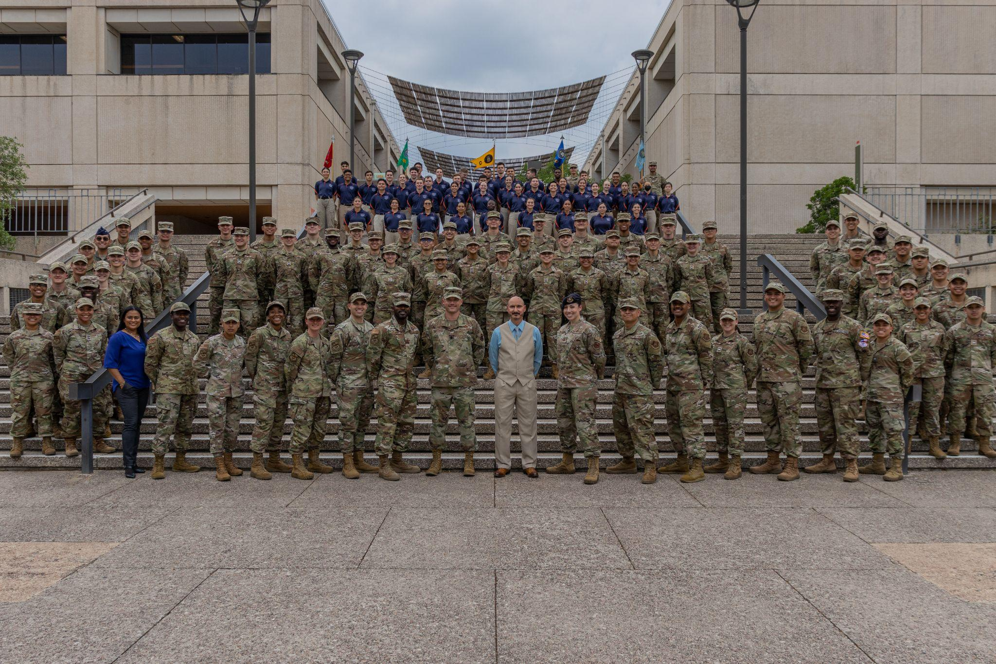
Air Force ROTC Detachment 842
The University of Texas at San Antonio
Det 842 – Best in Blue

